Slide 1
Discrete Mathematical Structures
Application of propositional logic
(命题逻辑的应用）

Slide 2
Applications of Propositional Logic: Summary
Translating English to Propositional Logic
System Specifications
Boolean Searching
Logic Puzzles
Logic Circuits

Slide 3
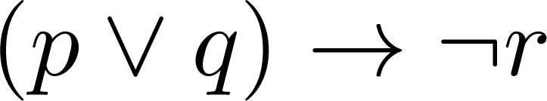
Translating English Sentences
Steps to convert an English sentence to a statement in propositional logic
Identify atomic propositions and represent using propositional variables.
Determine appropriate logical connectives
“If I go to Harry’s or to the country, I will not go shopping.”
p: I go to Harry’s
q: I go to the country.
r: I will go shopping.
If p or q then not r.

Slide 4
Example
Problem: Translate the following sentence into propositional logic:
“You can access the Internet from campus only if you are a computer science major or you are not a freshman.”
One Solution:
a : “You can access the internet from campus,”
c : “You are a computer science major,”
f : “You are a freshman.”
a only if (c ∨ ¬ f )
a→ (c ∨ ¬ f )

Slide 5
Translating English sentences
Example 2
You cannot ride the roller coaster if you are under 4 feet tall unless you are older than 16 years old.
q: “You can ride the roller coaster.”
r: “You are under 4 feet tall.” s: “You are older than 16 years old.”
¬q if (r ∧ ¬s)
The sentence can be translated to (r ∧ ¬s) → ¬q.

Slide 6
System Specifications
System and Software engineers take requirements in English and express them in a precise specification language based on logic.
Example:
Express in propositional logic: “The automated reply cannot be sent when the file system is full”
Solution
p : “The automated reply can be sent”
q : “The file system is full.”
¬ p when q
q→ ¬ p

Slide 7
Consistent System Specifications
Definition: A list of propositions is consistent if it is possible to assign truth values to the proposition variables so that each proposition is true.

Slide 8
Consistent System Specifications
Example 4
The diagnostic message is stored in the buffer or it is retrasmitted.
The diagnostic message is not stored in the buffer.
If the diagnostic message is stored in the buffer, then it is retransmitted
Solution:
p： “The diagnostic message is stored in the buffer.”
q： “The diagnostic message is retransmitted”
p ∨ q, ¬p, p→ q.
When p is false and q is true all three statements are true. So the specification is consistent.
What if “The diagnostic message is not retransmitted is added.”
Solution: Now we are adding ¬q and there is no satisfying assignment.
So the specification is not consistent.

Slide 9
Boolean searches
Definition：
Logical connectives are used extensively in searches of large collections of information. Because these searches employ techniques from propositional logic, they are called Boolean Searches.
Connectives: AND, OR, NOT
Example:
Web page searching.

Slide 10
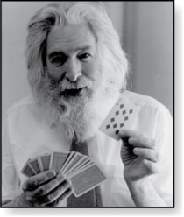
Logic Puzzles
Raymond Smullyan
(Born 1919)
An island has two kinds of inhabitants, knights, who always tell the truth, and knaves, who always lie.
You go to the island and meet A and B.
A says “B is a knight.”
B says “The two of us are of opposite types.”
Example: What are the types of A and B?
Solution: p: A is a knight and q :B is a knight. ¬p : A is a knave and ¬q : B is a knave.
If A is a knight, then p is true. Since knights tell the truth, q must also be true. Then (p ∧ ¬ q)∨ (¬ p ∧ q) would have to be true, but it is not. So, A is not a knight and therefore ¬p must be true.
If A is a knave, then B must not be a knight since knaves always lie. So, then both ¬p and ¬q hold since both are knaves.

Slide 11
Example 8
Muddy children puzzle
The father says “At least one of you has a muddy forehead,” and then asks the children to answer “Yes” or “No” to the question: “Do you know whether you have a muddy forehead?”
The father asks this question twice. What will the children answer each time this question is asked, assuming that
a child can see whether his or her sibling has a muddy forehead, but cannot see his or her own forehead?
Assume that both children are honest and that the children answer each question simultaneously.
Solution:
s: Son has a muddy forehead. d: Daughter has a muddy forehead. s∨ d
Both will answer ‘no’ the first time because each know other is true.
Both will answer ‘yes’ the second time.

Slide 12
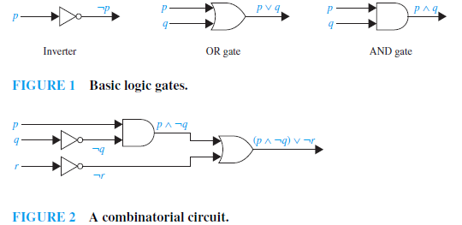
Logic Circuits
Electronic circuits; each input/output signal can be viewed as a 0 or 1.
0 represents False
1 represents True
Complicated circuits are constructed from three basic circuits called gates.

Slide 13
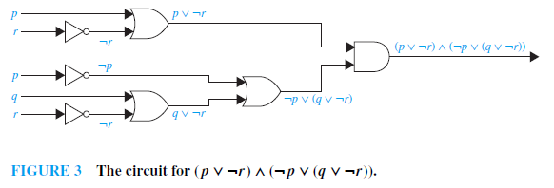
Logic Circuits
Example
Build a digital circuit that produces the output
(p∨ ¬ r)∧ (¬ p∨ (q ∨ ¬ r)) when given input bits p, q, and r.

Slide 14
EXAMPLE 10
Build a digital circuit that produces the output (p ∨¬r) ∧ (¬p ∨ (q ∨¬r)) when given input bits p, q, and r.

Slide 15
Homework
1.2
4,22,36,44

